Slide 1

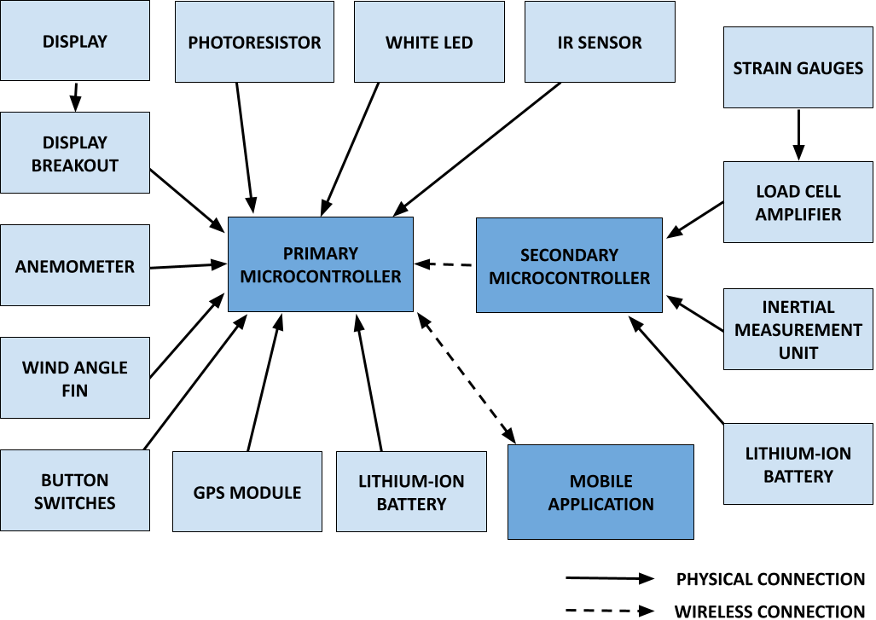
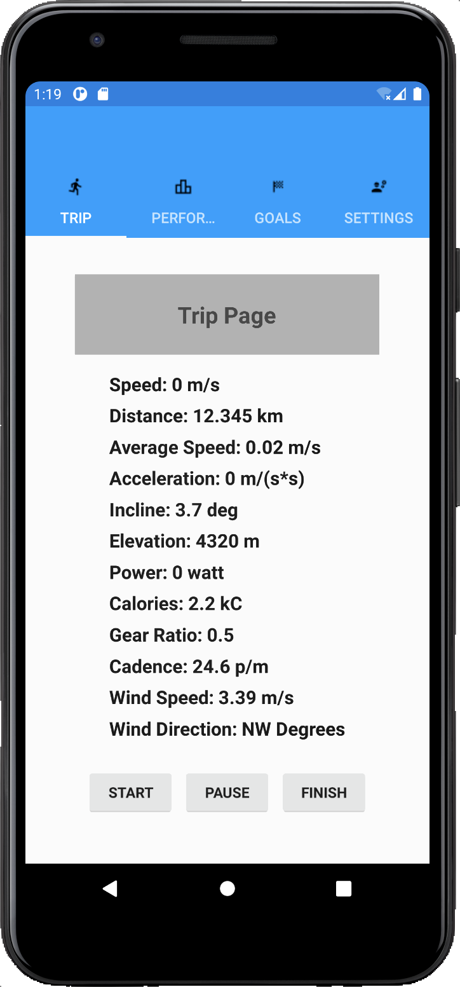
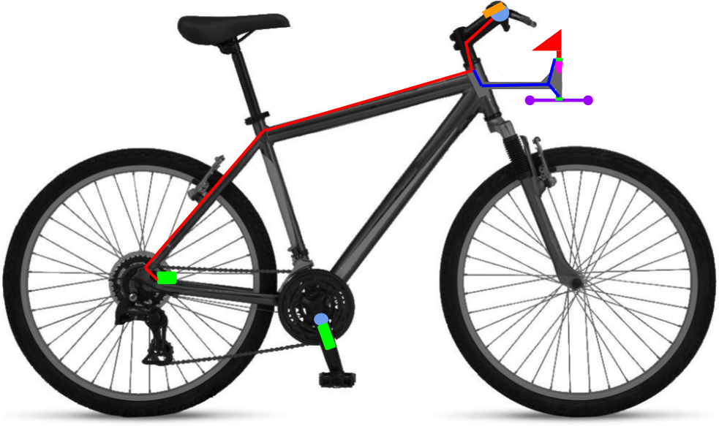
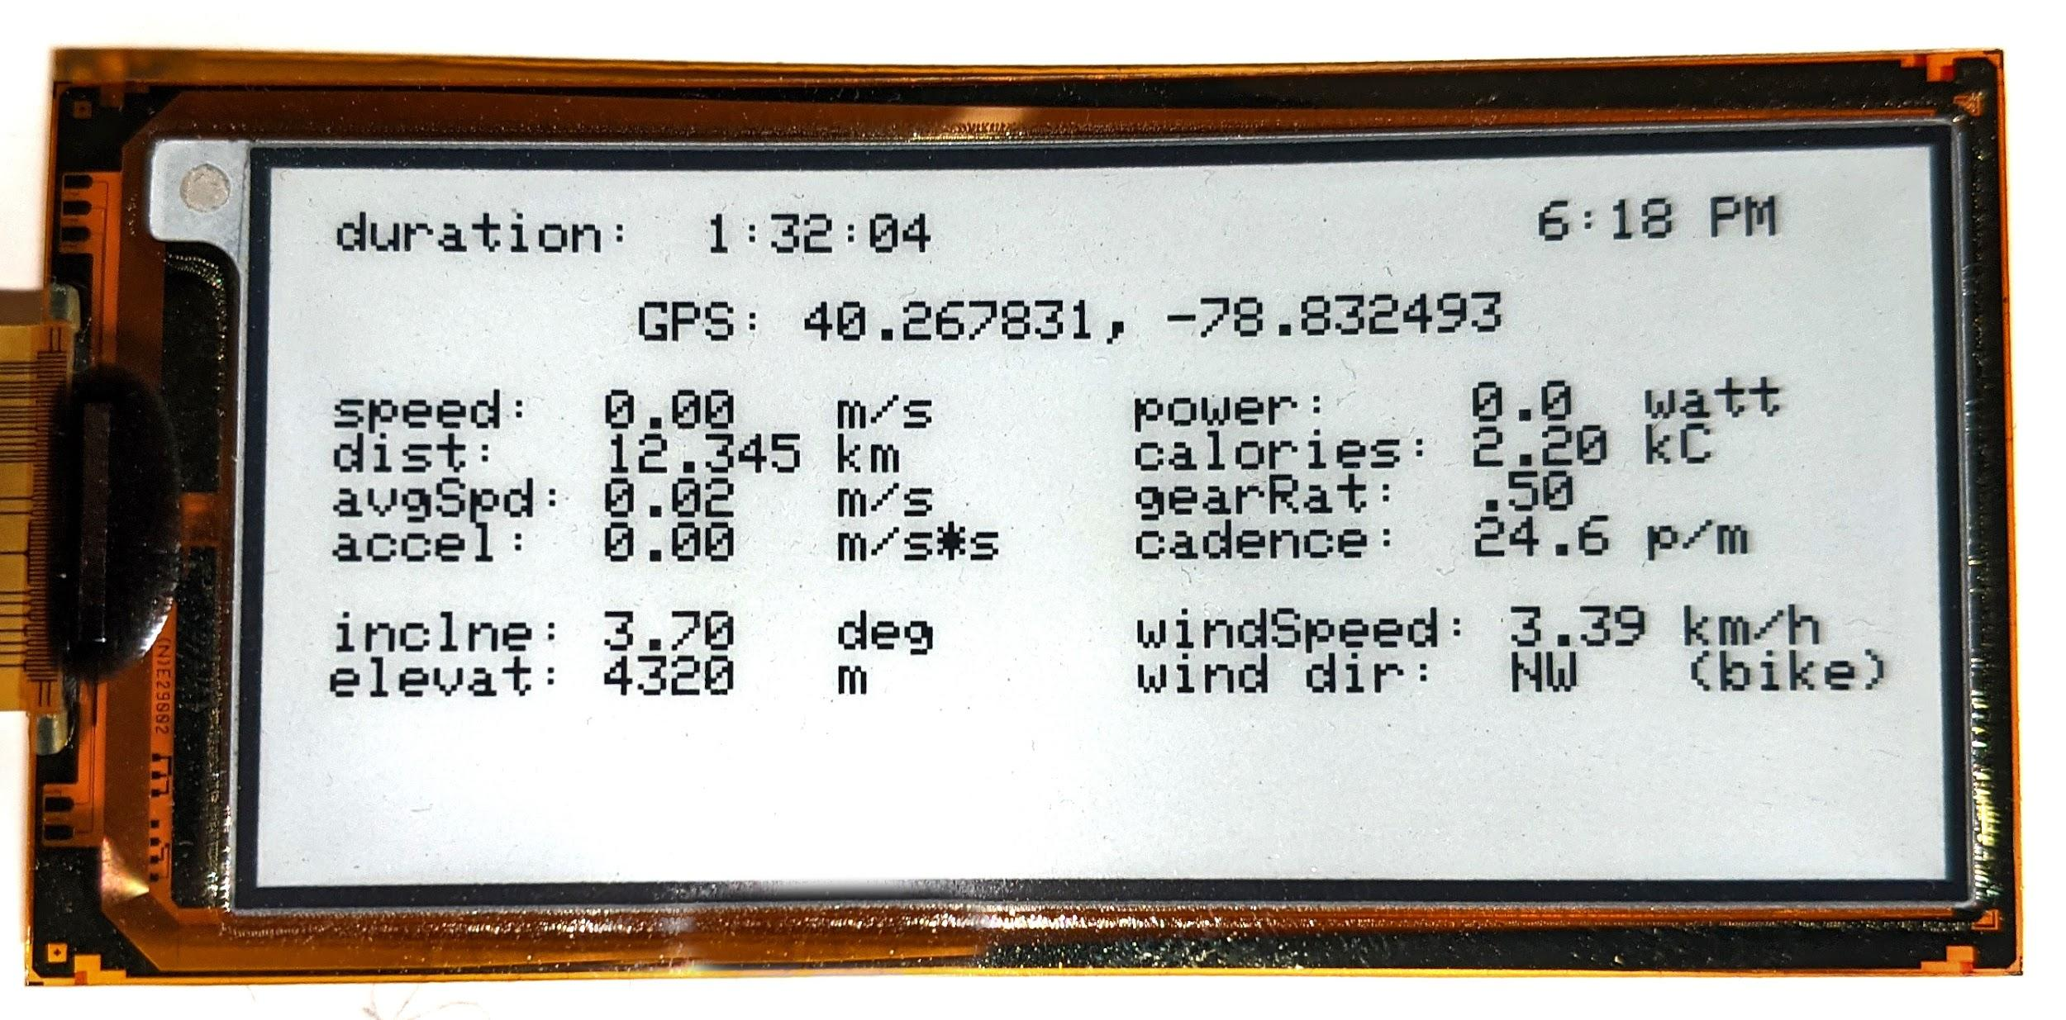
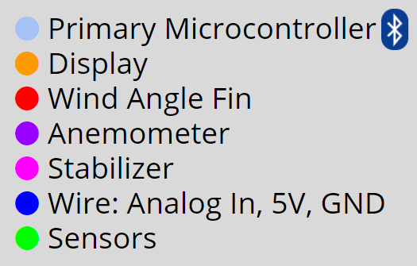
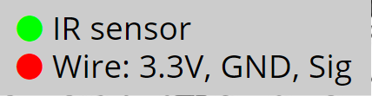

Cycle Statistic Tool
Cody Klingler, Jacob Hoffman
Computer Engineering
University of Pittsburgh at Johnstown
Abstract
Justification
Operation
System Block Diagram
The Cycle Statistic Tool is a data recording device which will be attached to the frame of a bicycle. In this position, several electronic components may be used to record statistics about a user’s cycling trip. The Cycle Statistic Tool will transmit data to a companion application that is installed on a user’s smartphone. This application will utilize the collected information to provide records of a user’s cycling sessions in the form of graphs and charts that enable the user to improve their cycling skills.
Problem Identification:
Currently, there are several wearable devices available for cyclists that offer general data collection about a cycling session; however, they do not offer specific statistic tracking for the user, only general data about the location, duration, and exercise of the cycling trip. The specialized meters that are available to cyclists currently offer very few measurements. Cyclists require a better, more encompassing solution for setting goals and tracking improvement.
The Cycle Statistic Tool is composed of two microcontrollers and the system of components connected to each. The microcontroller on the handle bars will be used as the primary device to connect all sensors and for operation of the device. The secondary microcontroller will be attached to the pedal shaft and will wirelessly relay data to the primary board. The block diagram in Figure 4 depicts how each component is connected to the system. The user will begin using the Cycle Statistic Tool by powering on and calibrating the device. Then, the user will pair the device to the mobile application with bluetooth. The user may begin recording a trip to their device by clicking ‘start’ on the mobile application. Live metrics will be displayed on the device and smartphone during usage. Finally, the trip may be saved by clicking ‘finish’ on the mobile application.
Engineering Formulation:
Sensors and components may be used to create a device designed to provide a large collection of cycling data. Transmitting cycling data to a companion application will provide record of each cycling session for use in improving a user’s cycling skills.
Figure 4: Block Diagram Illustration of Hardware Component Interactions
Figure 1: Companion Application
Figure 2: Cycle Statistic Tool Design
Figure 3: Display Mounted on Handlebars

Slide 2
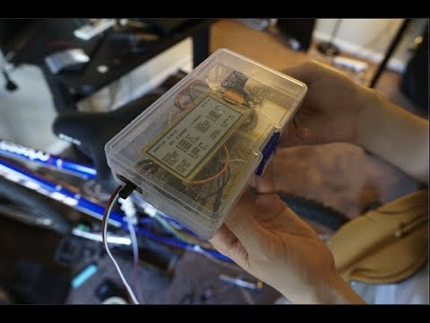
VIDEO DEMONSTRATION:

Slide 3
SOURCE CODE:
https://github.com/Jacob-Hoff-man/Companion

